Slide 1
Histogram of oriented gradients

Slide 2
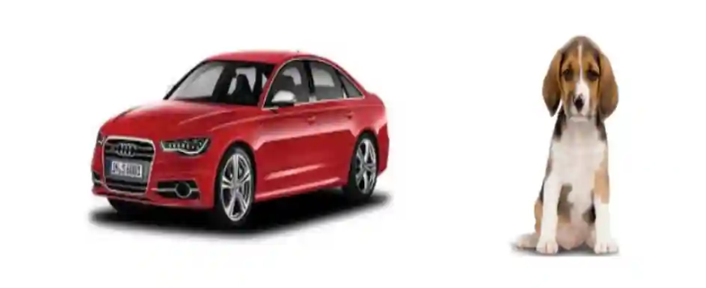
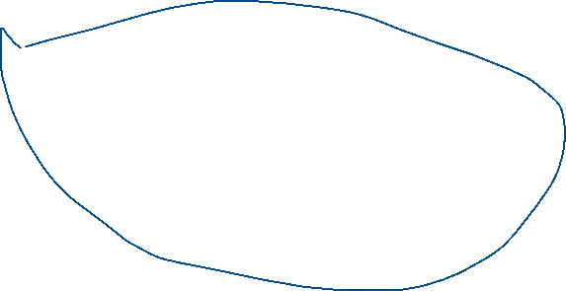
Introduction..
Feature descriptor
Take a look at the two images shown below. Can you differentiate between the objects in the image?

Slide 3
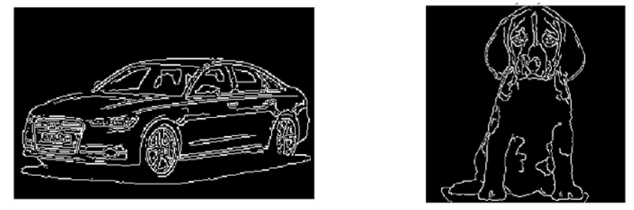
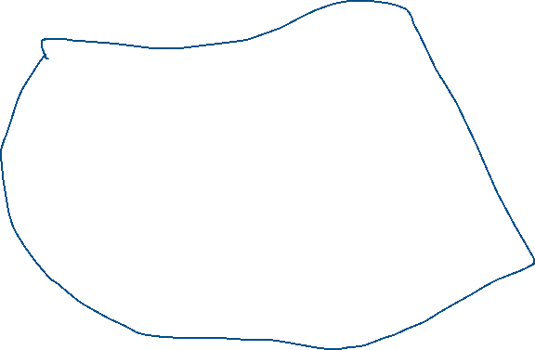
Feature descriptor
Can you guess what was the difference between the first and the second case? The first pair of images had a lot of information, like the shape of the object, its color, the edges, background, etc.
On the other hand, the second pair had much less information (only the shape and the edges) but it was still enough to differentiate the two images.

Slide 4
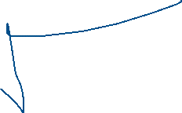



Continue..
It is a simplified representation of the image that contains only the most important information about the image
HOG: Histogram of Oriented Gradients
SIFT: Scale Invariant Feature Transform
SURF: Speeded-Up Robust Feature
What is Histogram of Oriented Gradients?
The Histogram of Oriented Gradients (HOG) is a popular feature descriptor technique in computer vision and image processing. It analyzes the distribution of edge orientations within an object to describe its shape and appearance. The HOG method involves computing the gradient magnitude and orientation for each pixel in an image and then dividing the image into small cells

Slide 5
The HOG feature descriptor counts the occurrences of gradient orientation in localized portions of an image.
Step 1: Preprocess the Data (64 x 128)
Step 2: Calculating Gradients (direction x and y)
Step 3: Calculate the Magnitude and Orientation
Step 4: Calculate Histogram of Gradients in 8×8 cells
Step 5: Normalize gradients in 16×16 cell (36×1)
Step 6: Features for the complete image

Slide 6
Step 1: Preprocess the Data (64 x 128)
Resize the Image to 64×128
Standardize all input images to this size.
This makes block division easier and aligns with the original HOG paper.

Slide 7
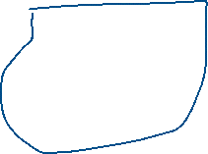

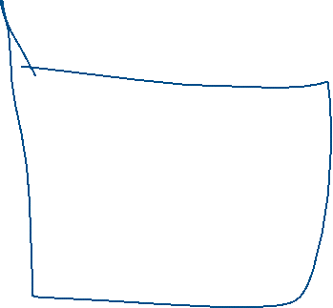
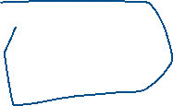
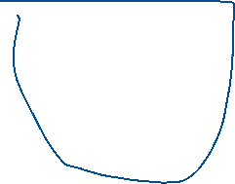
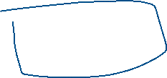

Step 2: Calculating Gradients (direction x and y)
Objective: Detect edge information in the image.
Method: Apply filters (like Sobel) to get gradients in x and y directions.
For each pixel:
Gx = I[x+1, y] − I[x−1, y] → Horizontal change
Gy = I[x, y+1] − I[x, y−1] → Vertical change
✅ These gradients capture intensity changes and are essential for edge detection

Slide 8

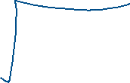




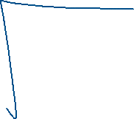


Step 3: Compute Magnitude and Orientation
Compute Magnitude and Orientation
Objective: Determine the strength and direction of edges.
For each pixel:
Magnitude = √(Gx² + Gy²) → Strength of the gradient
Orientation = atan2(Gy, Gx) (in degrees, range: 0°–180°) → Direction of the edge (unsigned angle)
✅ These values are the core inputs for building orientation histograms.

Slide 9
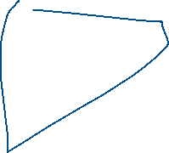




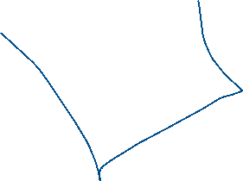
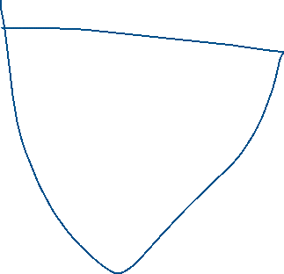

Step 4: Calculate Histogram of Gradients in 8×8 cells
For a 64×128 image: → (64 ÷ 8) × (128 ÷ 8) = 8 × 16 = 128 cells
Each 8×8 cell contains 64 pixels → Each pixel has a gradient magnitude and orientation
Build a histogram of gradients for each cell: → 9 orientation bins (0° to 180°, with 20° intervals) → Each pixel "votes" for a bin based on its orientation → The vote's strength = pixel’s gradient magnitude → If orientation lies between bins, vote is split proportionally
Result: A local descriptor of edge directions in each cell

Slide 10

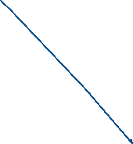


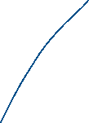


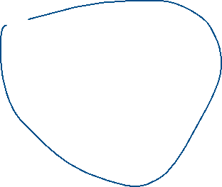
Normalize gradients in 16×16 cell (36×1)
Group 2×2 cells → one block of size 16×16 pixels
Slide the block across the image with a stride of 8 pixels
Blocks overlap, improving robustness
Each block contains: → 4 cells × 9 orientation bins = 36 values
Normalize this 36×1 feature vector to reduce effects of brightness/contrast:

Slide 11
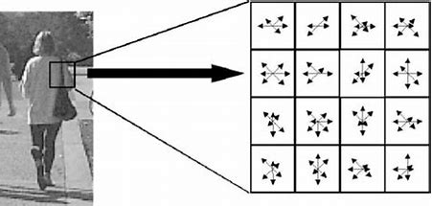
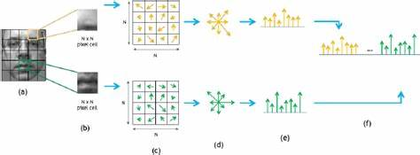


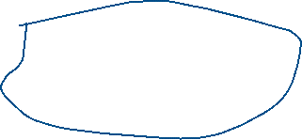

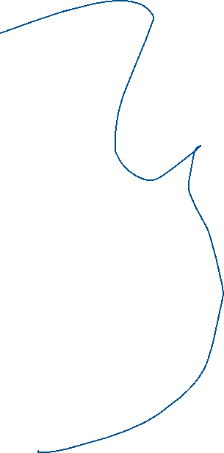





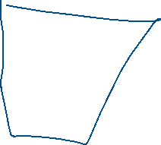


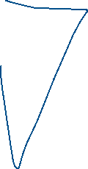

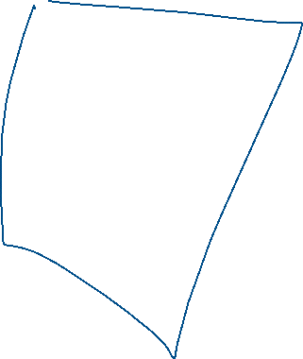

Slide 12
Thank you..

